Slide 1

Strategic Analytics Initiative Employee Development Program Utilization Analysis
Shan Ali Shah Sayed

Slide 2

Analysis Overview
Executive Summary
Employee Training Participation in Various Locations
Employee Participation over Different Courses
Enrollment Variation across Locations & Courses
Appendix
Recommendations

Slide 3
Executive Summary
This analysis examines Employee Development Program of Nexus Logistics Solutions in which they aim to significantly improve the skills and competencies of their employees across all their offices around the world. As employees learn through different courses, this analysis will focus on their course participation and identify trends across courses, office regions and countries. By analyzing over 19,000 enrollments across 30 countries, this study identifies and highlights key areas of strong engagement, potential growth and opportunities for optimal program utilization.
Key findings reveal that courses in Logistics Software Essentials and Advanced Transportation Management are the most popular, attracting over 6,000 enrollments combined, underscoring the industry's focus on software and transportation efficiency. In contrast, courses like Cybersecurity in Supply Chain Management have lower participation, highlighting a potential gap in awareness to new technologies or perceived relevance to their work in today’s digital landscape.
Geographically, offices in China and USA emerged as leaders in employee training participation, with cities like Shenzhen and New York each exceeding 600 enrollments. On the other hand, offices in Netherland, Ireland, and Spain demonstrated lower participation, indicating an opportunity to boost training engagement in these regions.
Employee participation trend also varies across different countries. While countries from South America showed great participation of employees, countries such as Japan and Netherlands show that employees are less likely to participate for the Employee Development Program.

Slide 4
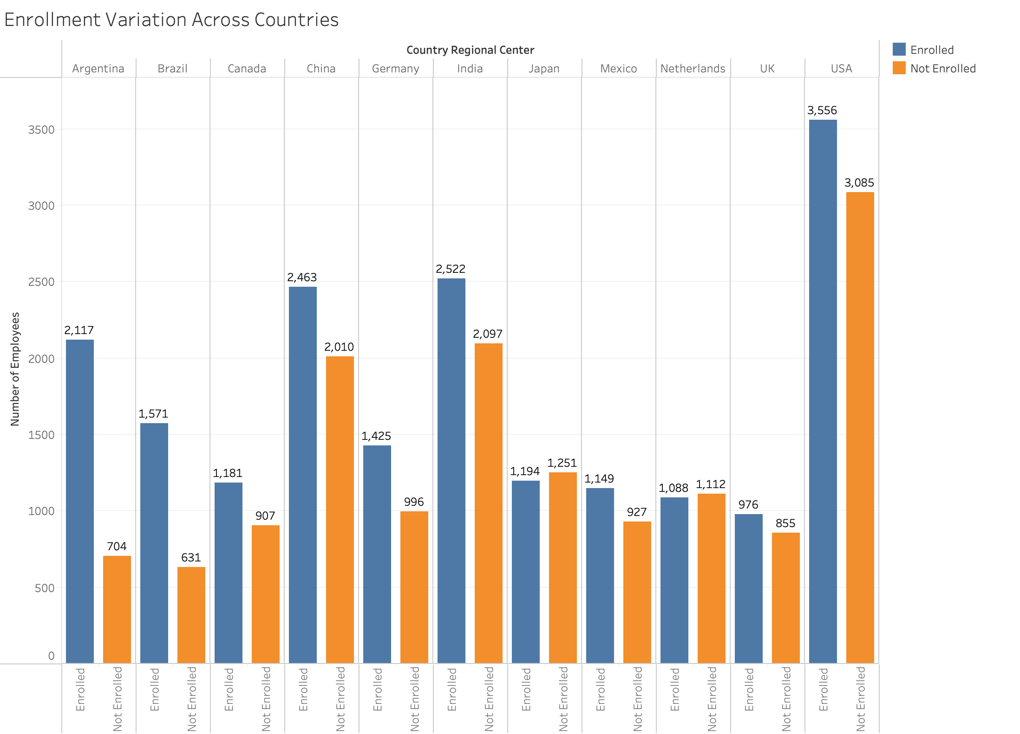
Employee Participation Varies Across Different Regions
The graph shows that in Japan and Netherlands, more than half of the employees are not enrolled in any course.
The participation is high in the graph for Argentina and Brazil as most of the employees in those countries enroll in courses and participate in the Employment Development Program.

Slide 5
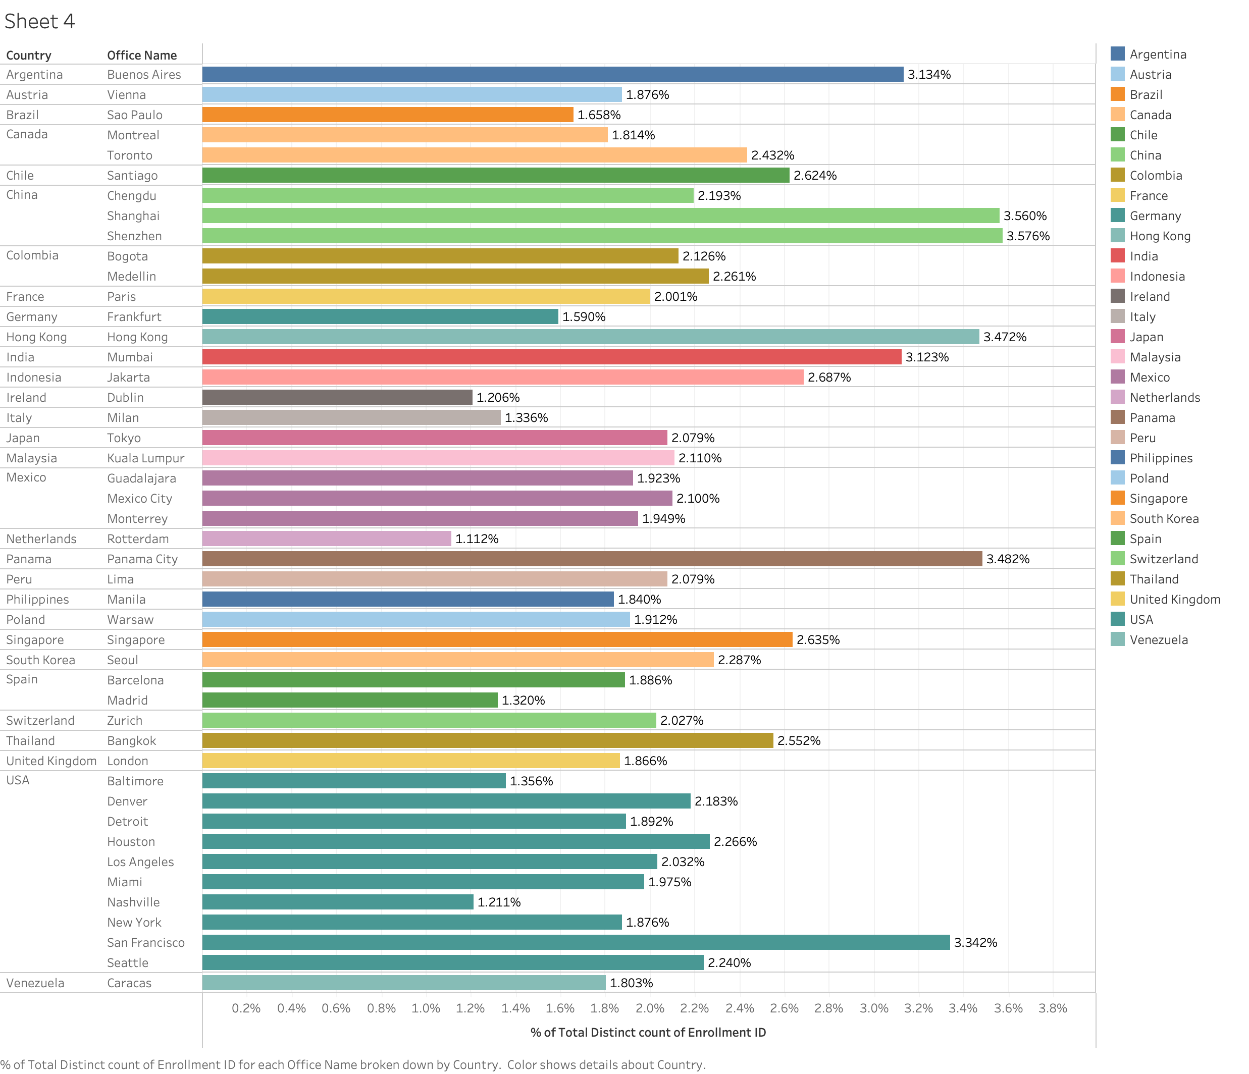
Training Participation Across 30 Countries
Key Insights:
While previous slide showed enrollment participation trend across countries, this graph presents a deeper analysis by showing office-wise participation trends.
The USA remains highly active, with Denver, Houston, and Los Angeles as leading offices. However, there’s significant variability across different offices in the USA.
China is a strategic region with multiple offices contributing consistently, although individual office percentages are lower compared to Colombia and USA.
European countries like Ireland, Spain, and Netherland have lower enrollments compared to other regions like the USA and Latin America.
Ways to increase participation:
Maximize investment in Colombia: With Bogota and Medellin driving significant engagement, it’s worth investing in further expansion or offering additional programs tailored to this region.
Boost underperforming offices: Explore why offices like Dublin, Madrid and Rotterdam have lower enrollments and address potential barriers or opportunities for growth.

Slide 6
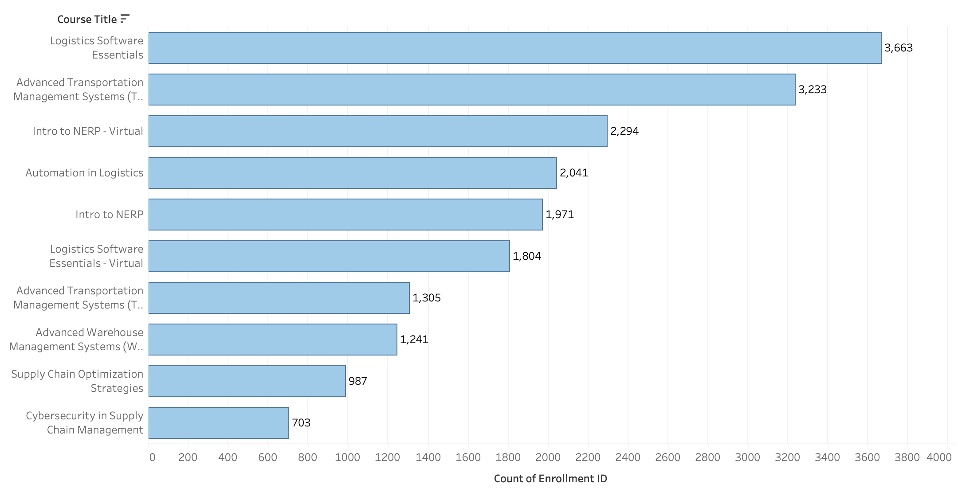
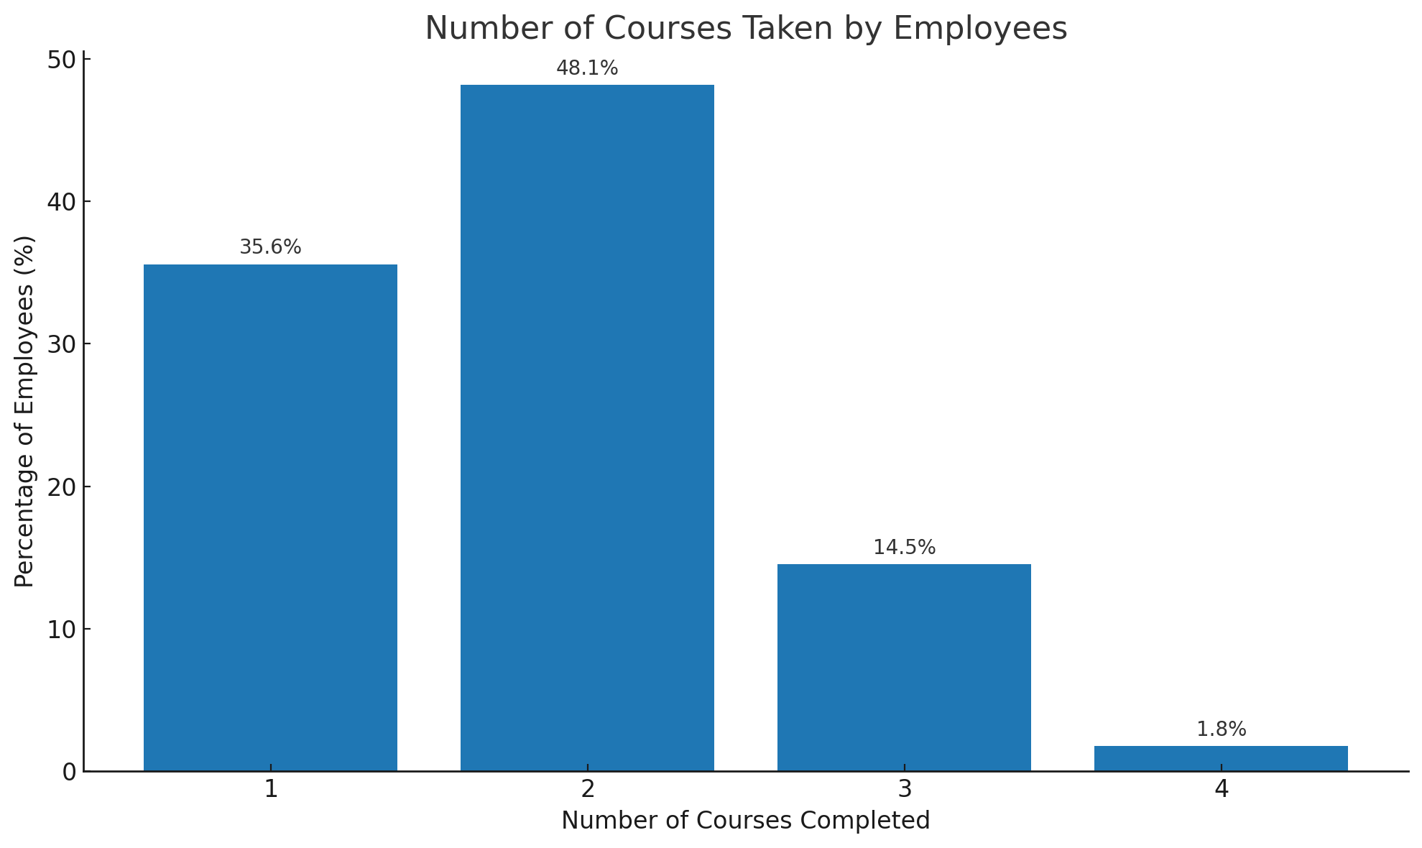
Top 3 Courses Attract Over 9,000 Employees
Key Insights:
The highest enrollments are for courses related to Software and Management systems, indicating that participants prioritize technical and operational knowledge within logistics.
The lower enrollments in Cybersecurity (703) and Supply Chain Optimization Strategies (987) is a likely indication to enhance awareness for these courses.
Virtual courses (e.g., Intro to NERP Virtual with 2,294 enrollments) show high participation, which may reflect a preference for flexible online learning options.
Key Insights:
The graph shows the number of courses an individual employee take while participating in the Employee Development Program.
Majority of employees are engaging in 1 to 2 courses, with almost half of the employees completing 2 courses.
There’s a noticeable drop-off after 2 courses, which could indicate that either the course structure, time constraints, or relevance to the employees’ roles diminishes after a certain point.
The very low engagement beyond 3 courses suggests either a lack of advanced or diverse course offerings.

Slide 7
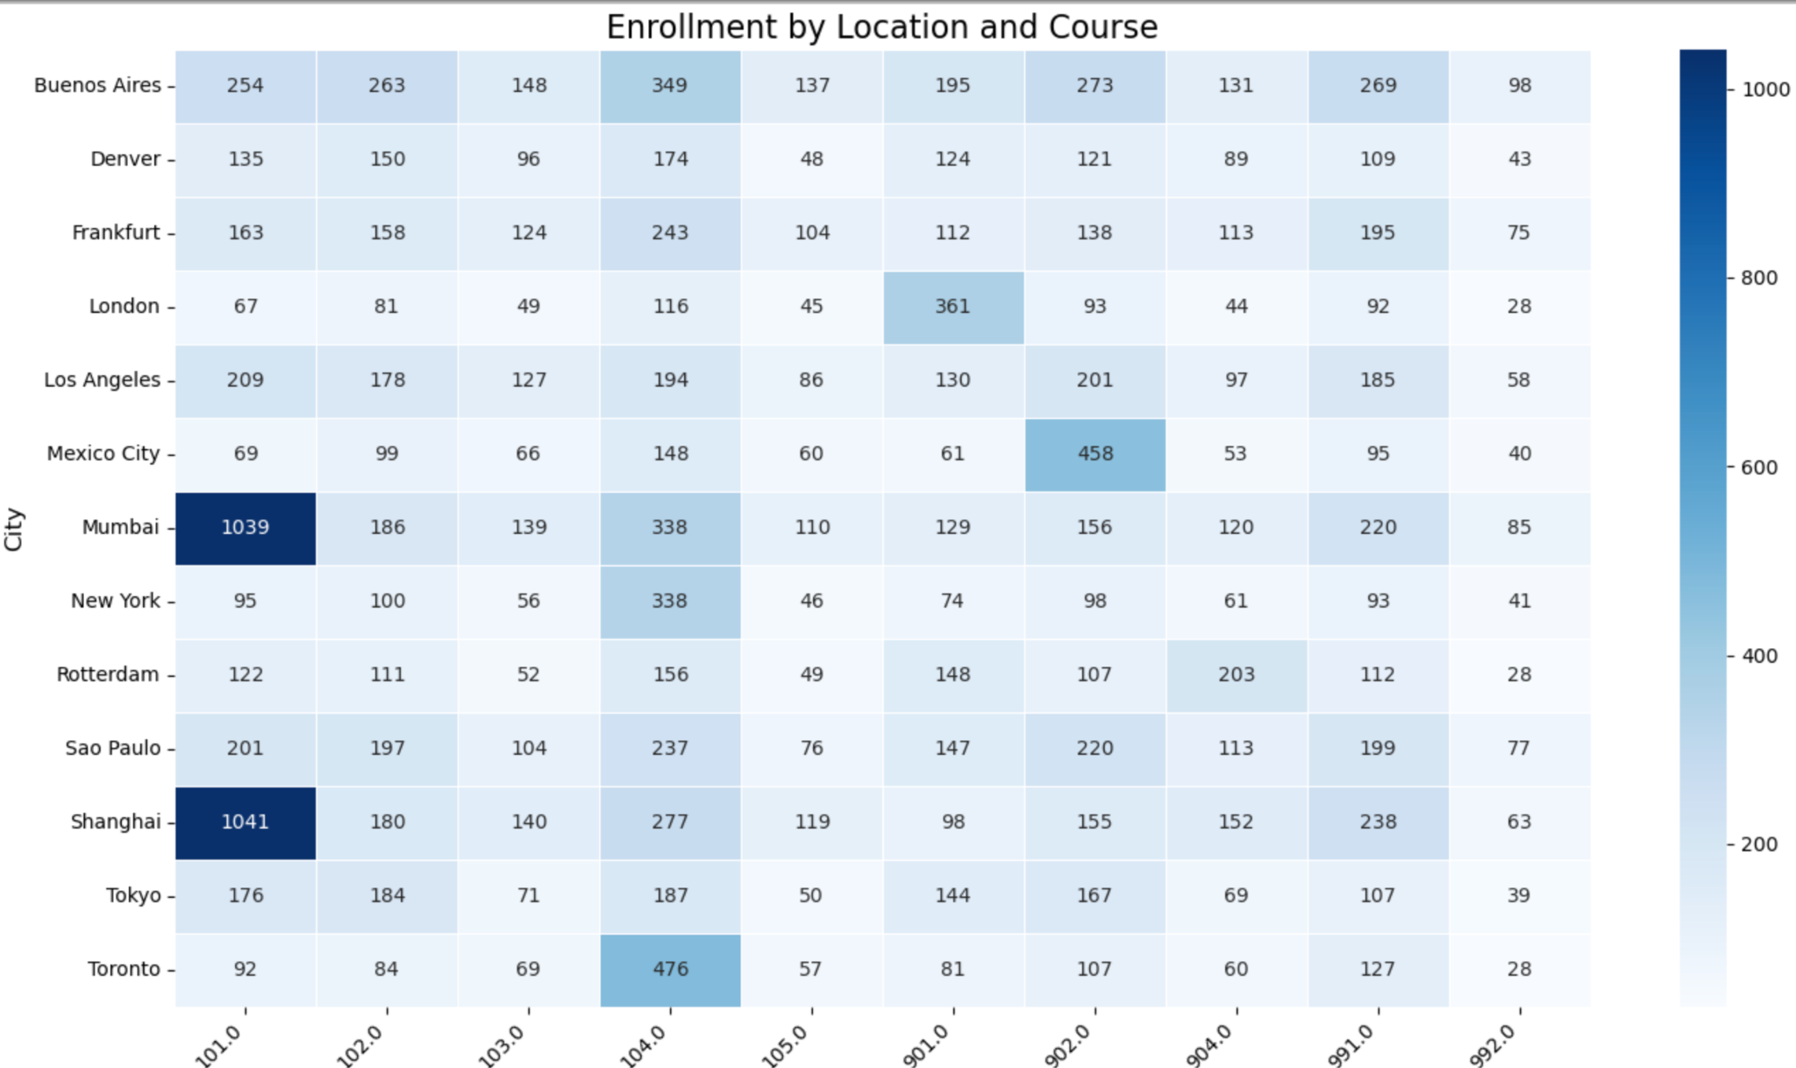
Enrollment variation by Location and Course
The graph highlights the courses which were taken by most employees in a particular city.
Regional Trends: Mumbai and Shanghai clearly dominate in terms of enrollment for certain courses, especially Logistic Software Essentials (101). This suggests high demand for these courses in these regions, potentially due to local market needs or population size.
Niche Markets: Cities like Mexico City and Toronto have unique course preferences, with the highest enrollments in Intro to NERP - Virtual (902) and Advanced Transportation Management Systems (TMS) (104) respectively.

Slide 8
Recommendations
Targeted strategy: For countries with low employee participation ratio, such as Japan and Netherlands, NLS can work on localized content, give promotions and incentivize the participation process.
Continue focusing on software-related courses: Courses like Logistics Software Essentials and Advanced Transportation Management Systems should remain a priority, as they drive the highest engagement.
Increase promotion and awareness of under-enrolled courses such as Cybersecurity in Supply Chain Management and Supply Chain Optimization. These are important topics but may require better marketing or content revision to match learners' interests.
Expand virtual course offerings: Given the strong engagement with virtual courses like Intro to NERP – Virtual, it may be worth exploring additional virtual options to cater to participants seeking flexible learning environments (Example: Mexico).
Encourage more participation in higher numbers of courses by introducing incentive programs for completing 3 or more courses. For example, offering certifications, bonuses, or career advancement opportunities tied to additional courses may boost engagement.

Slide 9
Appendix
Gen AI Usage:
ChatGPT was used to write python code for data merging and data cleaning.

Slide 10

Thank You!

